Slide 1

INSE 6610 CYBERCRIME INVESTIGATION A COMPREHENSIVE REVIEW OF CYBER-ATTACKS USING SPECIFIC CASES
Ajayi Samson(40202929)
Damilola Sanni(40199391)
Eunice Msheliza (40160778)
Jasmeen Kaur(40184380)
Olivia Okechukwu(40189600)
Varnesh Gawde(40159406)
Perehrat Sambo-Daju(40184186)
Manbir Singh(40191664)
Rowan Singh Sandhu(40196883)

Slide 2
Case Study - 1

Slide 3
2014 JP Morgan Chase Data Breach
The event that changed the world view towards cybercrime.

Slide 4
Brief
Company
Context
Attack
largest theft of customer data from a U.S. financial institution in history (“ the “U.S. Financial Sector hacks”) which ranged from approximately 2012 to mid-2015.
Beginning in June 2014, and ending in August 2014, hackers executed the hack of JP Morgan, during which they stole customer records of over 83 million customers of the organization. It is still considered to be one of the biggest data breaches of all time.
A data breach is an incident where information is stolen or taken from a system without the knowledge or authorization of the system's owner.
The 2014 JPMorgan Chase data breach was a cyberattack against American bank JPMorgan Chase that is believed to have compromised data associated with over 83 million accounts—76 million households (approximately two out of three households in the country) and 7 million small businesses. The data breach is considered one of the most serious intrusions into an American corporation's information system and one of the largest data breaches in history.

Slide 5
Challenges faced by the company and the clients
Challenge 1
Challenge 2
Challenge 3
Loss of Data
Loss of data leads losing important customer/company data which can lead to downfall of the company or the customer base.
Loss of Trust
Loss of data leads losing customer trust over companies integrity.
Identify and patch the Loophole.
It can take time for the victim company to identify the breach and can give enough time for the attacker to increase the intensity of the attack.

Slide 6
A Milwaukee security consulting firm Hold security in July 2014 had uncovered a repository of about a billion stolen passwords and usernames that were stolen by a gang of Russian hackers. Some of the stolen data belonged to the J.P Morgan Chase Corporate Challenge site.
The bank disclosed the attack and declared that login information of the affected accounts were not compromised, however, PII(names, email, phone numbers), postal addresses were obtained by hackers opening up the possibility of phishing attacks.
The four defendants netted hundreds of millions of dollars in stock-pump scheme and internet gambling operations,
Shalon pleaded guilty to all charges.
July 2014
Aug 2014
Sept 2014
Oct 2014
Nov 2015
2016
April 2017
Official declaration and details filled regarding the on the security fillings
Extradited to U.S
This was when J.P Morgan’s security team checked their corporate network and discovered they had been breached. They proceeded to halt the attacks.

Slide 7
The Loophole

Slide 8
Vulnerability #1
The lack of a two factor authentication server made it easy for the attacker to utilize the stolen credentials.
Something that would have been impossible if a 2FA was working at the time of the attack. Also the existence of unpatched software made it easy to initiate zero-day exploits.

Slide 9
Vulnerability #2
unpatched software vulnerabilities
It doesn't matter how much work you put into cybersecurity awareness within your company if you have any vulnerabilities in your system, software, or strategy. You’re leaving holes hackers can easily access. That’s where unpatched software can damage your business.

Slide 10
Vulnerability #3
Lack of importance of having a good host-based Intrusion Detection Software.
HIDS can detect attacks that cannot be seen by a Network-Based IDS since they monitor events local to a host. HIDS can often operate in an environment where network traffic is encrypted. HIDS are unaffected by switched networks.
HIDS can detect, and in some cases prevent, attacks that involve software integrity breaches, such as Trojan Horses.
HIDS have the ability to monitor local files for any changes or modifications.
HIDS can see the outcome of an attempted attack since they can directly access and monitor the data files and operating system processes targeted by the attack.

Slide 11
Vulnerability #4
Hackers also exploited the Heartbleed bug (a vulnerability in OpenSSL) that allowed hackers to steal information that is normally encrypted.
It’s a flaw in a product called OpenSSL which, ironically enough, is supposed to secure web traffic through encryption. This flaw is based on a “keep-alive” setting which can provide malicious attackers the ability to obtain up to 64 KB of unencrypted sensitive data from the memory space of a vulnerable OpenSSL server or client. It can expose passwords, emails and financial information or get private keys used for encryption – any of which could produce devastating results.

Slide 12
The Adversaries

Slide 13
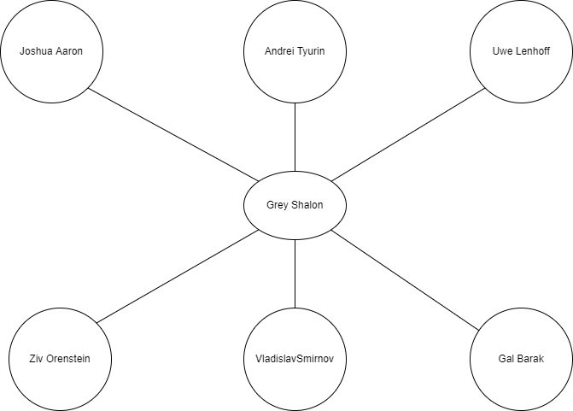
The Shalon Network

Slide 14
Prevention
• Host based Intrusion Prevention would have detected the presence of a malware on the employee’s computer
• Regular Patching of systems to ensure they are updated.
• Employee education.
• Application whitelisting guarantees the installation of only approved software on the network. This would have prevented the installation of the zero-day malware on the network.
• Implementing least privilege control access. This would have prevented the hackers from having the highest level of admin privileges.

Slide 15
Court Proceedings
Preet Bharara, The U.S Attorney of The Southern District of New York court charged:
Gery Shalon and Joshua Aaron with computer hacking, securities fraud, wire fraud and money laundering
Orenstien with securities fraud, wire fraud, running unlawful internet casino, running an illicit payment processor and money laundering

Slide 16
Court proceedings
with conspiracy to commit computer hacking, in violation of Title 18, United States Code, Section 371 (Count One)
; computer hacking, in violation of Title 18, United States Code, Sections 1030(a)(2)(A), 1030(c)(2)(B) and 2 (Count Two);
computer hacking, in violation of Title 18, United States Code, Sections 1030(a)(2)(C), 1030(c)(2)(B), and 2 (Count Three);
conspiracy to commit securities fraud, in violation of Title 18, United States Code, Section 371 (Count Four);
conspiracy to commit wire fraud, in violation of Title 18, United States Code, Section 1349 (Count Five);
securities fraud, in violation of Title 15, United States Code, Sections 78j(b) and 78ff, Title 17, Code of Federal Regulations, Section 240.10b-5, and Title 18, United States Code, Section 2 (Counts Six through Twelve);
wire fraud, in violation of Title 18, United States Code, Sections 1343 and 2 (Count Thirteen);
identification document fraud conspiracy, in violation of Title 18, United States Code, Sections 1028(f) and 2 (Count Fourteen);
aggravated identity theft, in violation of Title 18, United States Code, Sections 1028A and 2 (Count Fifteen);
Unlawful Internet Case 1:15-cr-00333-LTS Document 178 Filed 03/25/21 Page 1 of 21 2 Gambling Enforcement Act conspiracy, in violation of Title 18, United States Code, Section 371 (Count Sixteen);
; Unlawful Internet Gambling Enforcement Act, in violation of Title 31, United States Code, Sections 5363 and 5366, and Title 18, United States Code, Section 2 (Count Seventeen);
operation of an illegal gambling business, in violation of Title 18, United States Code, Sections 1955 and 2 (Count Eighteen);

Slide 17
Court proceedings
conspiracy to commit wire fraud, in violation of Title 18, United States Code, Section 1349 (Count Nineteen);
conspiracy to operate an unlicensed money transmitting business, in violation of Title 18, United States Code, Section 371 (Count Twenty);
operation of an unlicensed money transmitting business, in violation of Title 18, United States Code, Section 1960 and 2 (Count Twenty-One);
money laundering conspiracy, in violation of Title 18, United States Code, Section 1956(h) (Counts Twenty-Two and Twenty-Three);

Slide 18
Conclusion
The JP Morgan Chase breach is not an isolated incident. We have been seeing an ongoing trend of companies being attacked using flaws found in web apps. This often leads to business disruption, tampered brand image, or loss of critical information
To secure web applications, IT admins need to enforce good baseline web, application, and database server security practices. Ask if you really need all the services that are set to run on web servers, if only relevant ports are enabled, if passwords are strong, and access is limited.

Slide 19
Conclusion
JP Morgan Chase data breach occurred because of a single security fix that wasn’t applied to a single system.
This happens more than people might think. Many systems are exceedingly complex, and there can be archaic areas of the system, such as apps that are infrequently used, that aren’t going through security updates. If the entire system is not controlled, it’s very easy for these issues to occur. Internal IT audits should occur frequently
The Timeline: J.P. Morgan only noticed the attack because the hacker made a mistake; they were compromised for two months. This is very common. Some large organizations are compromised for over a year before they notice. And that’s a problem. The longer a system is compromised, the more data can be accessed, the more damage a hacker can do, and the less likely it is for the hacker’s actions to be traced.

Slide 20
Case Study - 2

Slide 21
The Mellisa Virus 1999

Slide 22
Overview
Introduction
The Attack (Technical Report)
Investigation
The Arrest
Court Proceedings

Slide 23
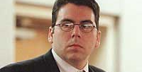
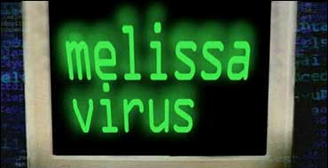
Introduction
The virus’s name is Melissa. It was written in Visual Basic by its creator, David Lee Smith, or Kwyjibo, who met a lap dancer in Florida, and that's how it got its name.
David L. Smith a programmer and a historian at Sewlyn College
The virus spread more quickly than any other in history

Slide 24
The Attack (Technical Report)
​By adding a new macro module called Melissa to a Microsoft Word 97 or Word 2000 document, it spreads among Outlook users. Only Outlook is affected by the malware; Outlook Express is unaffected.
Around March 26, 1999, Melissa was released. It began as a malicious file called "list.doc" that was uploaded on the "alt.sex" newsgroup, purporting to include a list of the usernames and passwords for 50 membership-required pornographic websites.
Once executed, Melissa's original version launches Outlook and sends itself to the first 50 addresses in the address book.
The infected user's PC was not seriously harmed by the virus. However, this led to Denial of Service (DOS) attacks on the network systems of companies like Microsoft, Intel, and many more that used MS Outlook as their email client. Due to an influx of messages produced by the virus, some large organizations had to shut down their mail systems.

Slide 25
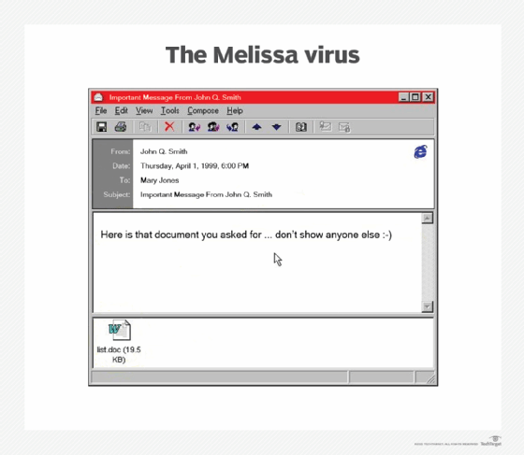
The Attack (Technical Report)
The subject of the email is “Important Message From <Username>”, where “Username” is taken from the MS Word setting. The body of the message is “Here is that document you asked for … don’t show anyone else ;-)”. The attachment is usually “list.doc”.
When an infected document is opened, Melissa checks if the Microsoft Office registry entry “HKEY_CURRENT_USER\Software\Microsoft\Office” has a subdirectory named “Melissa?” exists with “…by Kwyjibo” set as its value. If the value was set. Meaning the computer had been infected before, the virus would not do anything. If the value was not set, its primary payload would start the infection and then set the value.

Slide 26
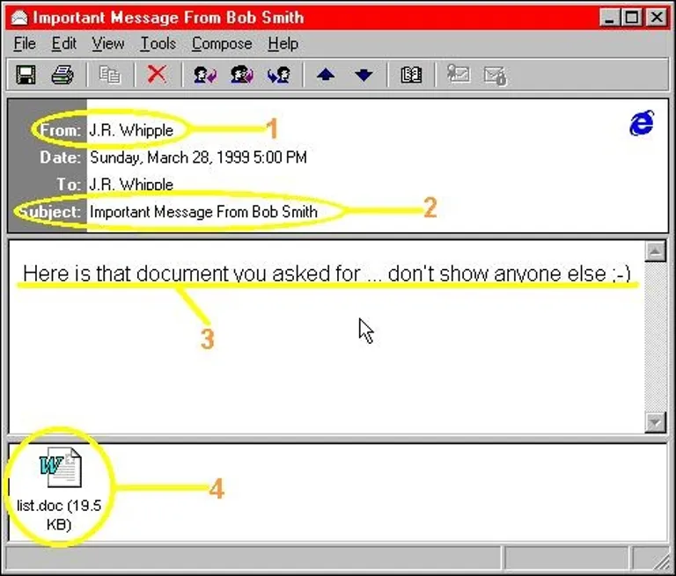
1 – It may be from someone you know. But they don’t know they sent it. 2- The subject line will read, “Important Message from” and the name may be someone you know. 3 – The body of the mail will read. “Here is that document you asked for don’t show anyone else ;-)” 4 – The attachment, where this nasty little bug lives, has the name of list.doc.
The Attack (Technical Report)

Slide 27
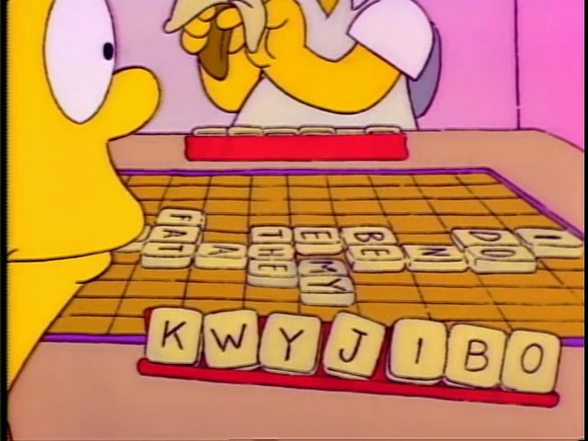
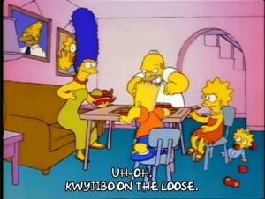
The Attack (Technical Report)
If an infected document was opened when the minute of the hour matched the day of the month after Melissa had infected the Normal.dot template, the macro would insert a passage from an episode of The Simpsons:
“Twenty-two points, plus triple-word-score, plus fifty points for using all my letters. Game’s over. I’m outta here.”
The quote is from Bart of “The Simpsons” cartoon show, who invents the word Kwyjibo to describe a North American ape or his father Homer in a Scrabble-playing episode

Slide 28
The macro then infects the NORMAL.DOT template file. By default, all Word documents utilize the template; thus, any other opened Word document could be infected.
If users send these infected documents to other people, they indirectly lend Melissa a hand in propagating it.
Similar to most macro viruses, the virus tries to hide its activities by disabling the following menu items:
1.. Tools-Macro in MS Word 2000
2. Macro- Security in Ms Word 2000

Slide 29
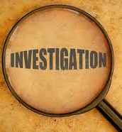
INVESTIGATION A manhunt to identify Melissa’s Virus creator
THE EMAIL CONNECTION
The source of the malicious mail was first posted by ‘Skyrocket@aol.com’
FBI asked AOL(web-based email service provider) for information regarding the email address
The email owned by Scott Steinmetz was hacked to post the virus
FBI investigators found out the same email account was linked with a website where virus writers posted their malicious codes
The website was traced to a web host at Access Orlando(a small ISP in Florida)
The web server owned by Roger Sibert hosted “source of kaos” a group of dubious websites
The web server was taken down by the FBI, and computers were seized to be examined in other to preserve any evidence of Melissa’s origin

Slide 30
THE MONMOUTH ISP CONNECTION
AOL alerted the New Jersey attorney general’s office about the IP address(209.191.60.64) of the computer where the virus may have originated from
This IP address was linked to Monmouth ISP in New Jersey
A warrant was delivered by state police to Monmouth ISP in relation to the IP address
The name of 12 clients who used the IP address on the day the virus was released were made available to the agents
David L. Smith was one of the clients
State police and FBI tech expert were able to link the IP address to the phone number and home address

Slide 31
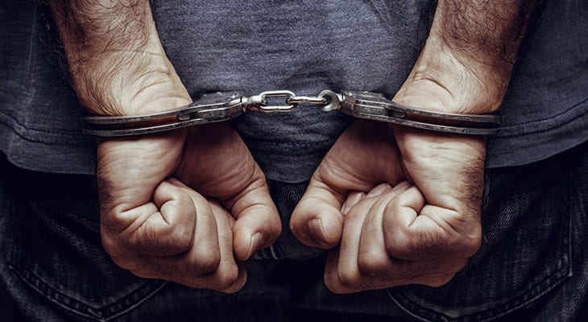
THE ARREST
A search warrant was gotten, and agents went to the suspect’s home in Aberdeen but could not find anyone
During the search they discovered CPU units from two computer systems were missing
The FBI was able to confiscate monitors, monitor cables, floppy disc, power cables, writeable CD-ROMs
They also questioned neighbors who gave them information about him
Among the information was the address of his brother who lived in the Eatontown residence
FBI arrested 30-year-old David L. Smith at his brother's residence
He was charged with interfering with public communications, stealing computer services, and gaining unauthorized access to computer system
He confessed to developing and disseminating the Melissa virus using the email address ‘skyrocket@aol.com’ and also erasing the computer used in creating it.

Slide 32
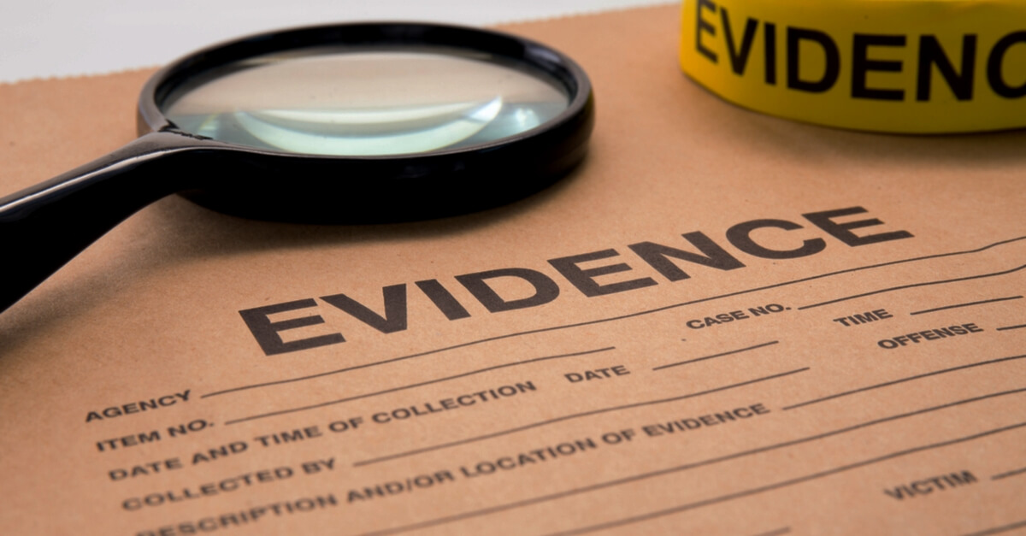
EVIDENCE
The email address initially used to upload the virus, skyrocket@aol.com
The web server owned by Roger Sibert was seized by the FBI.
The IP address (209.191.60.64) was given to the FBI by AOL.
Seized items from his apartment which include, floppy discs, writeable CD-ROMs, monitors, and power connections.

Slide 33
THE AFTERMATH
He pleaded guilty on 9th December 1999 in state and federal court after which he was granted bail
He has assumed a phony person and started assisting the FBI in locating and capturing other cybercriminals
Cyber criminals like Simon Vallor, the inventor of Gokar, Redisi-B, Admirer, and Jan De Wit the Dutchman who created the Anna Kournikova virus

Slide 34
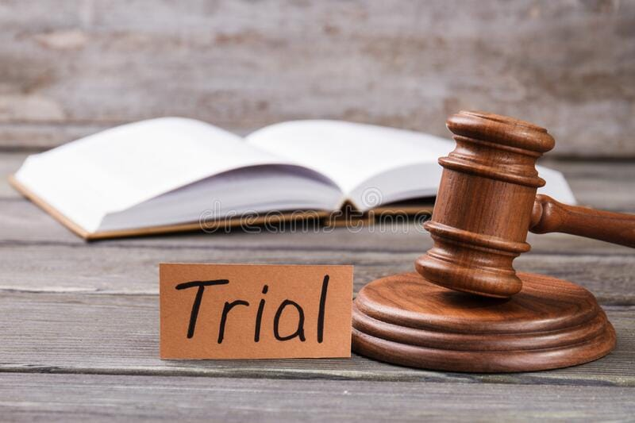
COURT PROCEEDING
UNITED STATES OF AMERICA VS DAVID L. SMITH
EDWARD F BORDEN Defence lawyer
DAVID L. SMITH Defendant
Nature of Crime: fraud and related activity in connection to computers (Title 18: US code section 1030(a)(5)(A) & 2
Date crime was committed: 26th March 1999
On 9th Dec 1999 defendant plead guilty to count(s) 1 of the information
Sentenced 1st May 2002 according to the sentencing reform Act of 1984
It is further stipulated that up until all fines are paid in full
The dependant must notify the United States Attorney for this district within 30 days of a change in name, place of residence, or postal address
Any significant change in the defendant’s financial situation, if they are required to make restitution, must be reported
This agreement was signed on May 3, 2002, by Joseph A. Greenaway Jr( Judge of United State)

Slide 35
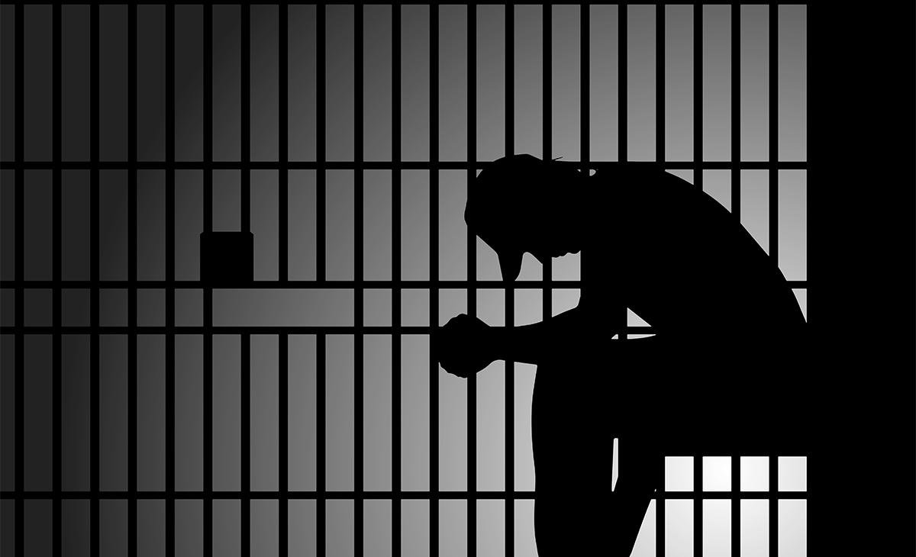
IMPRISONMENT
The defendant serves a 20 months sentence in the Federal Bureau of Prisons
The defendant must present themselves for sentence serving

Slide 36
SUPERVISED RELEASE
The defendant will spend 3 years under supervision after being released from prison
Standard requirement to be followed by the defendant under supervision
The defendant must submit to one drug test within 15 days and at least 2 more tests as determined by the probation supervisor
Within 72 hours of being released, the prisoner must appear in person at the probation office
It is a requirement that the defendant pay any fines or restitution obligations that are still owed after the term of supervised release has started
From the time probation is granted, the offender must complete 100 hours of community service over a period of 36 months or less. The court will recommend that the community service be carried out in the field of technology
The defendant is not permitted to use the internet, computer networks, or bulletin boards unless specifically permitted by the court
Upon the request by the US probation office, the defendant shall submit complete disclosure of his financial data, including annual income tax returns
If the US probation office so requests, the defendant must take part in a mental health program for evaluation and/or treatment

Slide 37
STANDARD-CONDITION OF SUPERVISION
During the period of supervision:
The offender shall not commit any more crimes at the federal, state, or municipal levels.
Forbidden for the defendant to illegally possess any controlled substances
The defendant must avoid going to locations where illegally obtained controlled substances are sold, used, distributed, or administered
The offender must routinely perform a legal job
The offender must abstain form excessive use of alcohol and must not buy, acquire, consume or distribute any narcotics or other related substances
The offender is not allowed to associate with any individual involved in criminal activity or those who have been convicted of a felony
Within the first 5 days of each month, the defendant must make a true and comprehensive written report to the probation officer

Slide 38
FINE
The offender must pay a $5000 fine
If the payment is not paid, the defendant could get any possible punishment that was initially given by the court
Title 18: US Code Section 3614 is cited as “ Resentencing upon failure to pay a fine or restitution”

Slide 39
Case Study - 3

Slide 40

TARGET ATTACK 2013

Slide 41
INTRODUCTION
Between November 27 and December 18, 2013, Target Corporation, a US retail company had its network infiltrated. The attackers were able to gain access to 40 million debit and credit card numbers as well as 70 million records of personal information after which they transferred all the data to servers in Eastern Europe and proceeded to erase it from target’s network.
This incident became the second-largest credit and debit card compromise after the TJX breach in 2007. The reissuing of cards alone after this event cost credit card unions more than $200 million by February 2014, a cost which rose significantly due to other bank reimbursement demands, regulatory fines, and direct customer service costs.

Slide 42
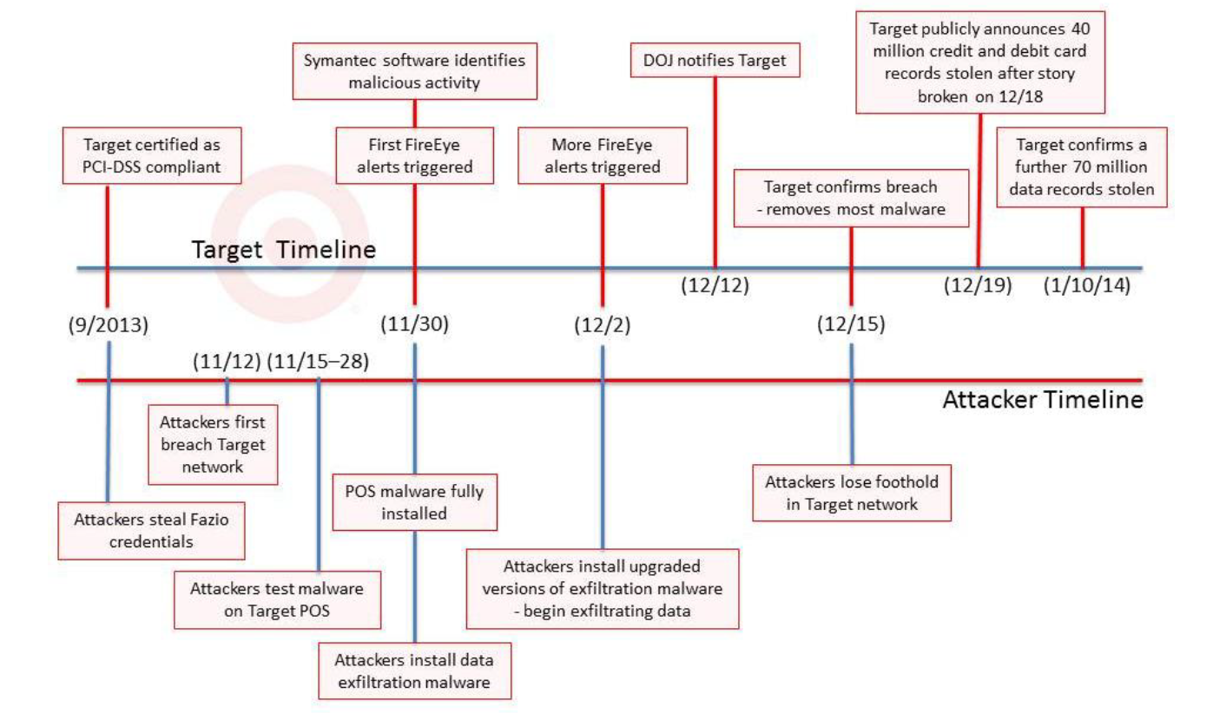
DETECTION/TIMELINE OF THE ATTACK

Slide 43
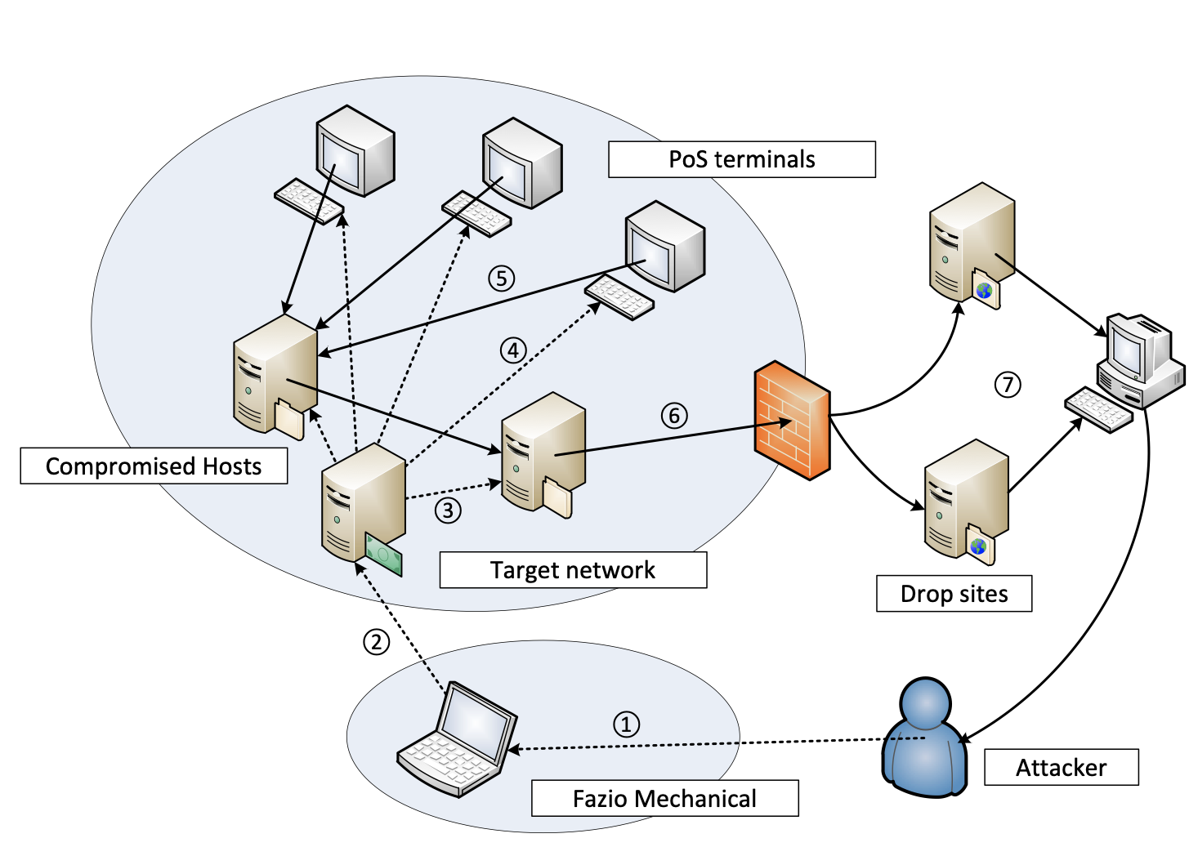
STAGES OF THE ATTACK
Initial Infection
POS infection
Data Collection
Data Exfiltration
Monetization

Slide 44
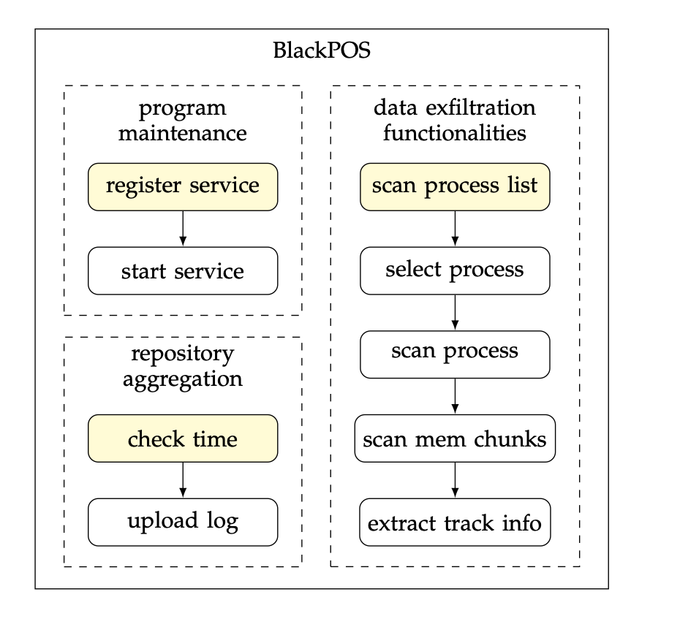
THE MALWARE – BLACKPOS

Slide 45
THE MALWARE- BLACKPOS
Multi-Phase Data exfiltration
String Obfuscation
Self-destructive code
Data encryption
Constrained Communication
Customized Attack vector

Slide 46
THE INVESTIGATION
Verizon Security Professionals investigated from dec 21 2013 to mar 1 2014.
Initial breach happened at Fazio Mechanical Services ( one of the target’s vendors)
Fazio relied on Malwarebytes leading to infection of citadel malware.
Data was stolen from target’s systems since it didn’t really cared about the security measure taken by its vendors.
MS SQL with weak admin password, Apache Tomcat with default Password.
Problem with maintenance and repairing parts of the systems.
Outdated software used like Apache, IBM Web Spheres, PHP

Slide 47
CATEGORY OF CRIME
Breach comes under the CFAA, gaining unauthorized access to a computer involved in overseas trade producing a loss more than $5000. Thus, the person could get up to 5 to 10 years of prison adding up with up to $250k damages per crime.
The federal Computer Fraud and Abuse Act (CFAA)
Gain constrained govt. data with no authorization
Access and misuse govt. data
Retrieving valued data for fraud
Forming traffic in the guarded device.
Blackmail, giving threats to harm devices.

Slide 48
THE TRIAL
Trial was held in Alexandria Federal Court
Scan4You program was used by hackers.
Bondars argued he wasn’t aware of the illegitimate users
Defense Attorney Jessica Carmichael argued that there are legal and illegal users of every online software
Judge Liam O’Grady concluded that there was a zero chance Bondars was not aware his software Scan4You wasn’t used my hackers.

Slide 49
THE CHARACTERS AND SENTENCE
Daniel Carmen Garcia & Daniel Guardiola Dominguez
Mexican Couple
Arrested in Texas with 96 Target cards
No record of Trial for the case
Ruslan Bonders:
Prisoned for 14 years
37-year old Latvian
Made Scan4You Program
This Program led hacker to misuse it
Andrey Hodirevski:
Ukrainian in his 20s
Suspect in pre card stings
No public record of him being responsible for the breach.

Slide 50

LESSONS LEARNED
Not Incorporating two factor authentication for all third-party vendors
Improper auditing of third-party vendor security
Handling data for too long in an insecure manner.
Not paying attention to security alerts
Improper segmentation of network

Slide 51

THINGS TARGET DID WELL
User Friendly website for its customers
Sincere apologies were made (CEO statement)
Held harmless promise to its Customers
Setup various points of contact (Help-lines)

Slide 52
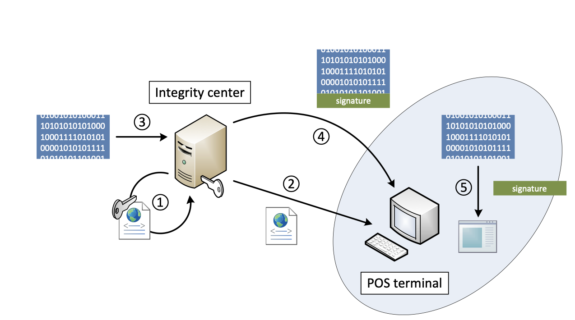
ENFORCED PAYMENT SYSTEM INTEGRITY

Slide 53
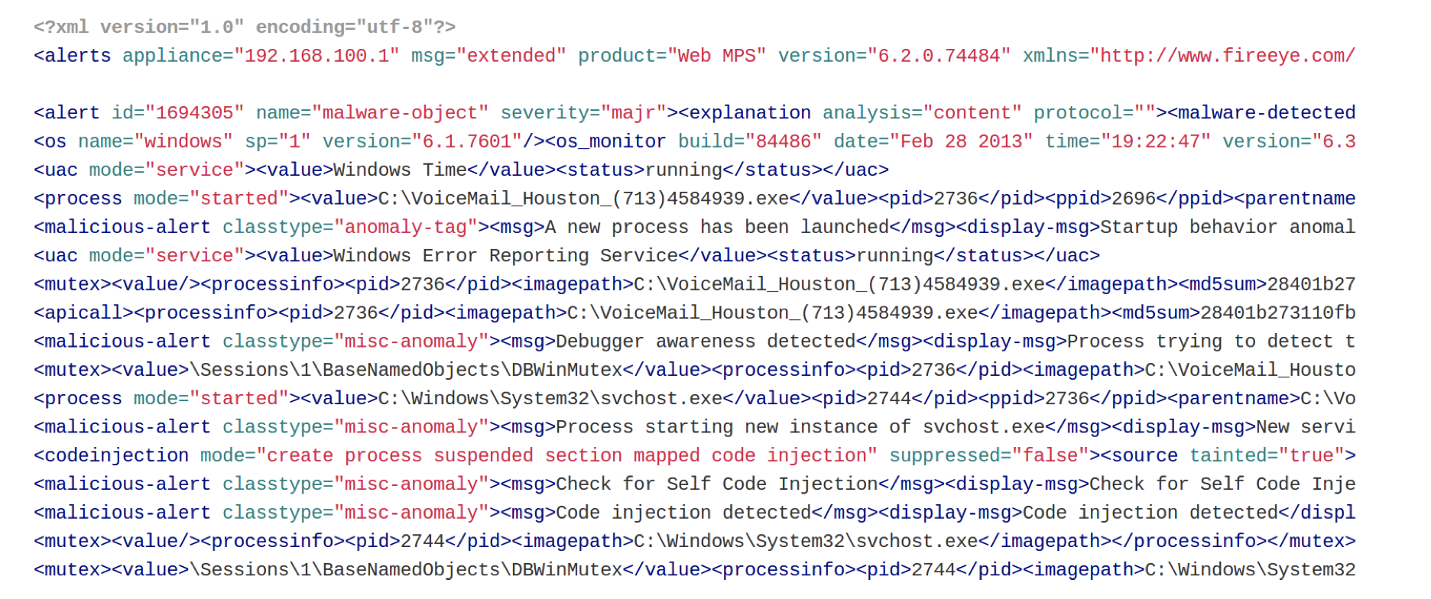
DEVELOPED EFFECTIVE SECURITY ALERT SYSTEMS (FIRE EYE)

Slide 54



CONTROLLED INFORMATION FLOW WITH NETWORK SEGMENTATION
Segmenting sensitive assets from the normal network
Implementing Zero-trust network
Properly configured Virtual LANS

Slide 55
CREDIT CARD SECURITY AND BEST PRACTICES
EMV (Europay , Mastercard and Visa)
Tokenization and Data Masking

Slide 56
CONCLUSION
There is no silver bullet in the cyber space

